Slide 1
ARG Matching and Modeling

Slide 2


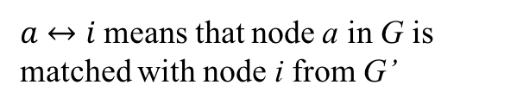

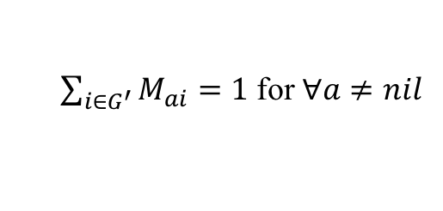
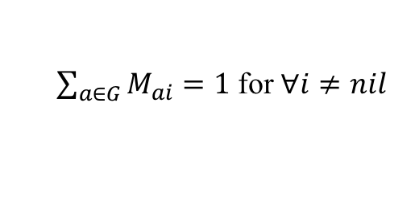
Mathematic Formulation
The energy of matching two ARGs $G$ and $G^{′}$ is defined as
$$E\left(G,G^{′},M\right)=−\frac{1}{2}\sum_{a∈G}{\sum_{b∈G}{\sum_{i∈G^{′}}{\sum_{j∈G^{′}}{M_{ai}M_{bj}C(a↔i,b↔j)}}}}−α\sum_{a∈G}{\sum_{i∈G^{′}}{M_{ai}C(a↔i)}}$$
Subject to:
$$M≥0$$
Both G and G’ contain a nil node.
$\sum_{i∈G^{′}}{M_{ai}}=1$ for $∀a≠nil$
$a↔i$ means that node a in G is matched with node i from G’
$\sum_{a∈G}{M_{ai}}=1$ for $∀i≠nil$
$$C\left(a↔i,a↔i\right)=0$$
$$C\left(a↔i,b↔j\right)=C\left(b↔j,a↔i\right)$$

Slide 3







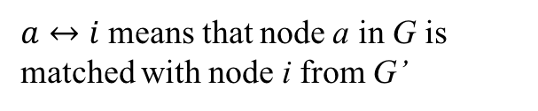

New Mathematic Formulation
The energy of matching two ARGs $G$ and $G^{′}$ is defined as
$$E\left(G,G^{′},M\right)=−\frac{1}{2}\sum_{a∈G}{\sum_{b∈G}{\sum_{i∈G^{′}}{\sum_{j∈G^{′}}{M_{ai}M_{bj}C(a↔i,b↔j)}}}}−α\sum_{a∈G}{\sum_{i∈G^{′}}{M_{ai}C(a↔i)}}$$
Subject to:
$$M≥0$$
Both G and G’ contain |G’| nil nodes and |G| nil nodes.
$\sum_{i∈G^{′}}{M_{ai}}=1$ for $∀a≠nil$
$a↔i$ means that node a in G is matched with node i from G’
$\sum_{a∈G}{M_{ai}}=1$ for $∀i≠nil$
$$C\left(a↔nil\right)>0$$
$M_{ai}$ = 0 for $∀a≠i+|G|$
$$C\left(nil↔nil\right)=0$$
$M_{ai}$ = 0 for $∀i≠a+|G′|$
$$C\left(a↔nil,b↔nil\right)>0$$
$$C\left(a↔i,b↔nil\right)=0$$
$$C\left(a↔i,a↔i\right)=0$$
$$C\left(a↔i,b↔j\right)=C\left(b↔j,a↔i\right)$$

Slide 4
New Mathematic Formulation
The energy of matching two ARGs $G$ and $G^{′}$ is defined as
$\frac{ΔE\left(G,G^{′},M\right)}{ΔM_{ai}}=−\sum_{b∈G }{\sum_{j∈G^{′}}{M_{bj}C(a↔i,b↔j)}}−αC(a↔i$)

Slide 5
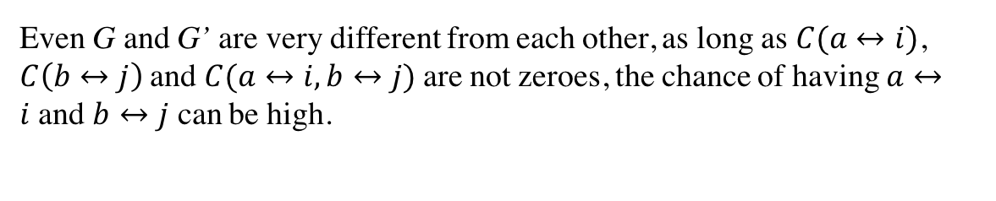
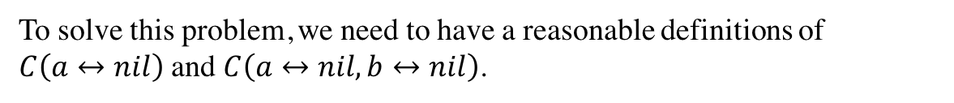
The Problem
G
a
b
nil
G’
i
j
nil
Even G and G’ are very different from each other, as long as $C(a↔i)$, $C\left(b↔j\right)$and $C(a↔i,b↔j)$are not zeroes, the chance of having $a↔i$and $b↔j$ can be high.
To solve this problem, we need to have a reasonable definitions of $C\left(a↔nil\right)$ and $C\left(a↔nil,b↔nil\right)$.

Slide 6
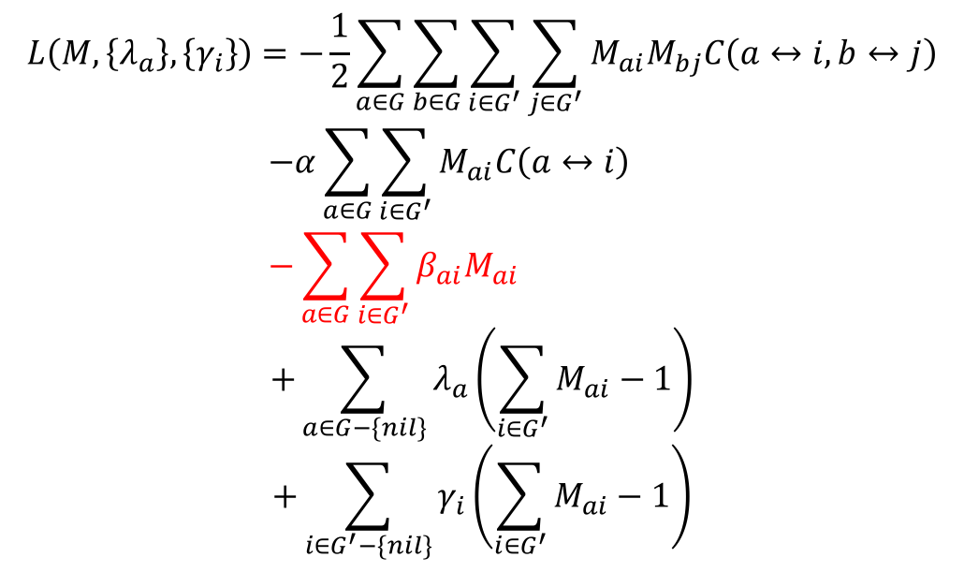
Solve Graph Matching
Use Lagrange multipliers to incorporate the constraints into the cost function.
$$L\left(M,\left\{λ_{a}\right\},\left\{γ_{i}\right\}\right)=−\frac{1}{2}\sum_{a∈G}{\sum_{b∈G}{\sum_{i∈G^{′}}{\sum_{j∈G^{′}}{M_{ai}M_{bj}C\left(a↔i,b↔j\right)}}}}$$
$$−α\sum_{a∈G}{\sum_{i∈G^{′}}{M_{ai}C\left(a↔i\right)}}$$
$$−\sum_{a∈G}{\sum_{i∈G^{′}}{β_{ai}M_{ai}}}$$
$$+\sum_{a∈G−\{nil\}}{λ_{a}\left(\sum_{i∈G^{′}}{M_{ai}}−1\right)}$$
$$+\sum_{i∈G^{′}−\{nil\}}{γ_{i}\left(\sum_{i∈G^{′}}{M_{ai}}−1\right)}$$
No more normalization and soft-assign?

Slide 7
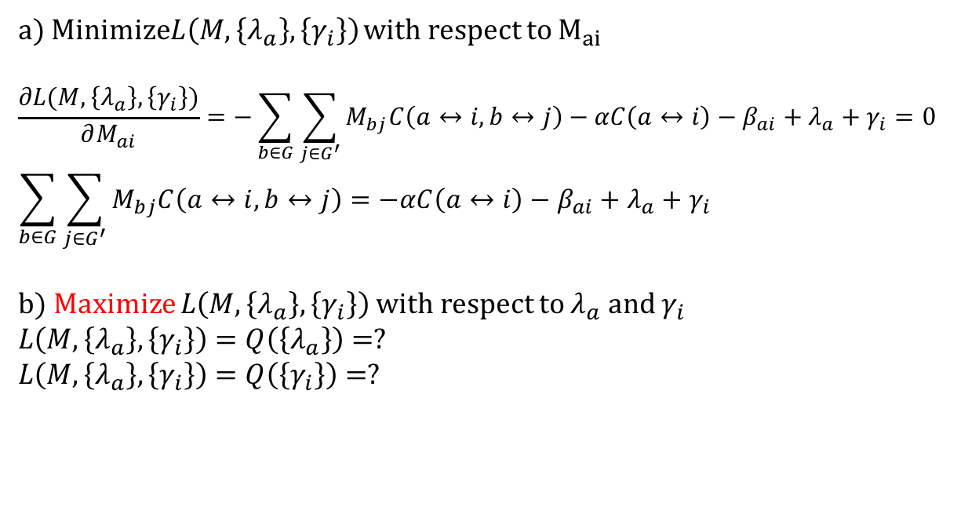
a) Minimize$L\left(M,\left\{λ_{a}\right\},\left\{γ_{i}\right\}\right)$ with respect to $M_{ai}$
$$\frac{∂L(M,\left\{λ_{a}\right\},\left\{γ_{i}\right\})}{∂M_{ai}}=−\sum_{b∈G}{\sum_{j∈G^{′}}{M_{bj}C\left(a↔i,b↔j\right)}}−αC\left(a↔i\right)−β_{ai}+λ_{a}+γ_{i}=0$$
$$\sum_{b∈G}{\sum_{j∈G^{′}}{M_{bj}C\left(a↔i,b↔j\right)}=−αC\left(a↔i\right)−β_{ai}+λ_{a}+γ_{i}}$$
b) Maximize $L\left(M,\left\{λ_{a}\right\},\left\{γ_{i}\right\}\right)$ with respect to $λ_{a}$ and $γ_{i}$
$$L\left(M,\left\{λ_{a}\right\},\left\{γ_{i}\right\}\right)=Q\left(\left\{λ_{a}\right\}\right)=?$$
$$L\left(M,\left\{λ_{a}\right\},\left\{γ_{i}\right\}\right)=Q\left(\left\{γ_{i}\right\}\right)=?$$

Slide 8
Model Training Process
1st Randomly pick $n$ graphs as components
2nd Perform graph matching between components and sample graphs to calculate matching probability
3rd Update nodes and edges of the components to maximize the matching probability based on 2nd step
EM Iterations
4th Output the components once the update is small

